Slide 1



Noida Institute of Engineering and Technology, Greater Noida
Acquiring & Engaging Users through Digital Channels
Unit: 3
Acquiring & Engaging Users through Digital Channels
Mr. Anup
MBA Department
B.Tech CSE Semester VI

Slide 2

Index/Content
S. No. | Index
1. | Name of Subject with code, Course and Subject Teacher
2. | Brief Introduction of Faculty member with Photograph
3. | Evaluation Scheme
4. | Syllabus
5. | Branch wise Application
6. | Course Objective(s)
7. | Course Outcome(s)
8. | Program Outcomes (POs)
9. | COs and POs Mapping

Slide 3
Index/Content
S. No. | Index
10. | Program Specific Outcomes (PSOs)
11. | Cos and PSOs Mapping
12. | Program Educational Objectives (PEOs)
13. | Result Analysis
14. | End Semester Question paper Templates
15. | Prequisite/Recap
16. | Brief Indtroduction about the Subject with Videos
17. | Unit Contents
18. | Unit Objectives
19. | Topic Objectives/Topic Outcome

Slide 4
Index/Content
S. No. | Index
20. | Lecture related to topic
21. | Daily Quiz
22. | Weekly Assignment
23. | Topic Links
24. | MCQs
25. | Glossary Questions
26. | Old question papers
27. | Expected Questions
28. | Recap of unit

Slide 5

Syllabus
UNIT-I | Introduction to Digital Marketing | Hours- 8
Introduction to Digital Marketing: Concept of Marketing, the new digital world - trends that are driving shifts from traditional marketing practices to digital marketing practices, the modern digital consumer and new consumer’s digital journey. Marketing strategies for the digital world-latest practices.
UNIT-II | Social Media Marketing | Hours-8
Introduction to Blogging, Create a blog post for your project. Include headline, imagery, links and post, Content Planning and writing. Introduction to Face book, Twitter, Google +, LinkedIn, YouTube, Instagram and Pinterest; their channel advertising and campaigns
UNIT-III | Acquiring & Engaging Users through Digital Channels | Hours-8
Understanding the relationship between content and branding and its impact on sales, search engine marketing, overview of search engine optimization (SEO), mobile marketing, video marketing, and social-media marketing. Marketing gamification, marketing analytic tools to segment, target and position.

Slide 6
Syllabus
UNIT-IV | Designing Organization for Digital Success | Hours-8
Digital transformation, digital leadership principles, online P.R. and reputation management. ROI of digital strategies, how digital marketing is adding value to business, and evaluating cost effectiveness of digital strategies
UNIT-V | Digital Innovation and Trends |  | Hours-8
The contemporary digital revolution, digital transformation framework; security and privatization issues with digital marketing Understanding trends in digital marketing – Indian and global context, online communities and co-creation.

Slide 7
Applications
With the advent of new technologies, the field of Marketing has seen a paradigm shift over the years.
Though it is still in use, businesses across the world have switched from traditional modes of marketing to digital marketing.
This, in turn, has created many new opportunities for companies to expand their business and has created tremendous employment opportunities across sectors.
From Content curation and management to Social Media Marketing and Brand Management, a career in Digital Marketing can take you in several directions.
Top Job Profiles: Digital Marketing Manager, Social Media Manager, Content Writer, Data and Market Analytics Manager

Slide 8
Course Objectives
1 | Provide understanding of digital and social media marketing practices.
2 | Provide understanding of different social media platforms
3 | Impart learning on various digital channels and how to acquire and engage consumers online.
4 | Provide insights on building organizational competency by way of digital marketing practices and cost considerations.
5 | Develop understanding of the latest digital practices for marketing and promotion.

Slide 9
Course Outcomes
CO 1 | Develop an understanding of digital and social media marketing practices. | Knowledge (K2), Remembering (K1)
CO 2 | Develop understanding of the social media platforms | Comprehending (K 3)
CO 3 | Acquire the skill to acquire and engage consumers online | Knowledge (K2), Applying (K4)
CO 4 | Develop understanding of building organizational competency by way of digital marketing practices and cost considerations | Knowledge (K2), Analyzing (K5)
CO 5 | Develop understanding of the latest digital practices for marketing and promotion. | Knowledge (K2), Applying (K4)

Slide 10
Program Outcomes
PO1: Knowledge of Management theories and practices
PO2: Analytical & Critical thinking abilities
PO3: Value based leadership
PO4: Understand, analyze and communicate all aspects of business
PO5: Achievement of Organizational goals

Slide 11
Program Educational Objectives
PEO 1: To have an excellent scientific and engineering breadth so as to comprehend, analyze, design and provide sustainable solutions for real-life problems using state-of-the-art technologies.
PEO 2: To have a successful career in industries, to pursue higher studies or to support entrepreneurial endeavors and to face the global challenges.
PEO 3: To have effective communication skills, professional attitude, ethical values and a desire to learn specific knowledge in emerging trends, technologies for research, innovation and product development and contribution to society.
PEO 4: To have life-long learning for up-skilling and re-skilling for a successful professional career as an engineer, scientist, entrepreneur or bureaucrat for the betterment of the society.

Slide 12
Program Specific Objectives
The ability to identify, analyze real world problems and design their ethical solutions using artificial intelligence, robotics, virtual/augmented reality, data analytics, block chain technology, and cloud computing.
The ability to design and develop the hardware sensor devices and related interfacing software systems for solving complex engineering problems.
The ability to understand inter-disciplinary computing techniques and to apply them in the design of advanced computing.
The ability to conduct investigation of complex problems with the help of technical, managerial, leadership qualities, and modern engineering tools provided by industry-sponsored laboratories.

Slide 13
Result Analysis
Subject Name & Code | Total No. Of Students | Pass % | 40>65 (%) | 65>75 (%) | 75>90 (%) | 90 & Above (%) | Backlog | Average Marks

Slide 14
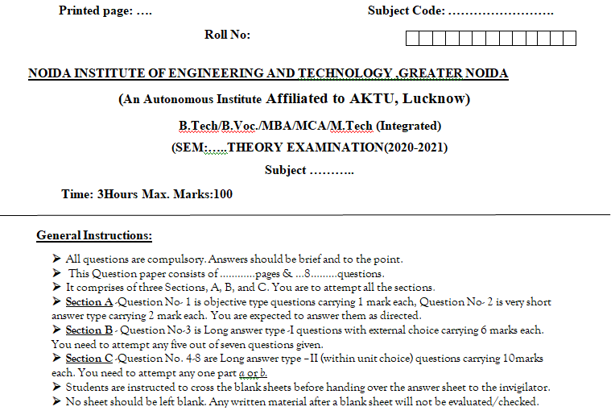
End Semester Question Paper Template

Slide 15
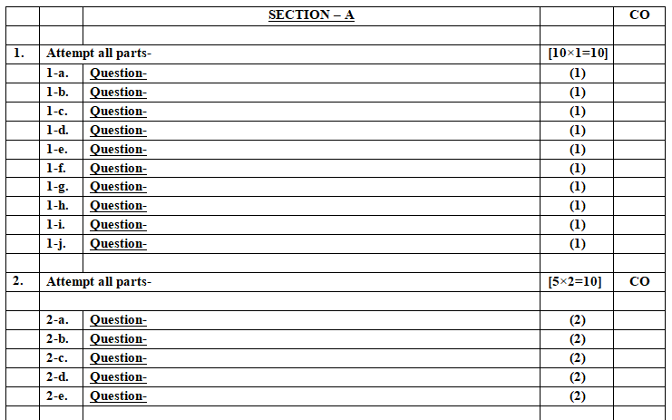
End Semester Question Paper Template

Slide 16
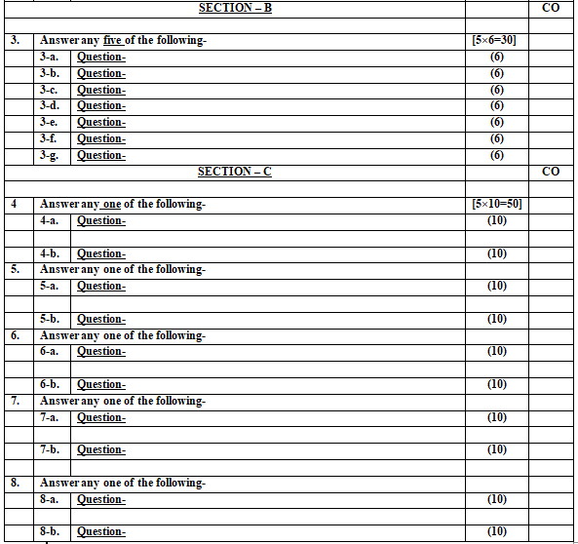
End Semester Question Paper Template

Slide 17
Prerequisite and Recap
Pre-requisites: Understanding of Basics of marketing concepts and social media platforms

Slide 18
Introduction of the subject
The course is designed to make learner conversant with Digital Marketing and proficient in Social Media tools and techniques starting from the fundamentals of digital marketing.
Social media websites and applications allow users to create and exchange user-generated content where people talk, share information, participate and network through technologies such as blogs and social networking sites.
Within the last decade, social media has become one of the most powerful sources for news updates, online collaboration, networking, viral marketing and entertainment.
https://www.youtube.com/watch?v=Xuq6_udbeH0&list=PLi3oNa09iwJRByiNwEJNaZ3XVKcveovzk
https://www.youtube.com/watch?v=X-pCbWwu50k

Slide 19
Unit Contents
Understanding the relationship between content and branding and its impact on sales. (CO3)
Search engine marketing, overview of search engine optimization. (SEO) (CO3)
Mobile marketing, video marketing, and social-media marketing. (CO3)
Marketing Gamification. (CO3)
marketing analytic tools to segment, target and position. (CO3)

Slide 20
Objectives of the Unit
To make the students understand the concept of Search engine marketing.
To explain the different types of Online marketing: Mobile, Video and social media marketing.
To make students understand SEOs ,Market gamification and marketing analytics tool to segment, target and position.

Slide 21

Noida Institute of Engineering and Technology, Greater Noida
(Unit –III) Topic 1
Understanding the relationship between content and branding and its impact on sales

Slide 22
Session Objectives
1. To develop a general understanding on Digital Marketing among the students.
2. To help students gain insights as to why digital marketing is gaining so much importance .
3. To enable students understand the shift from traditional to digital marketing.

Slide 23
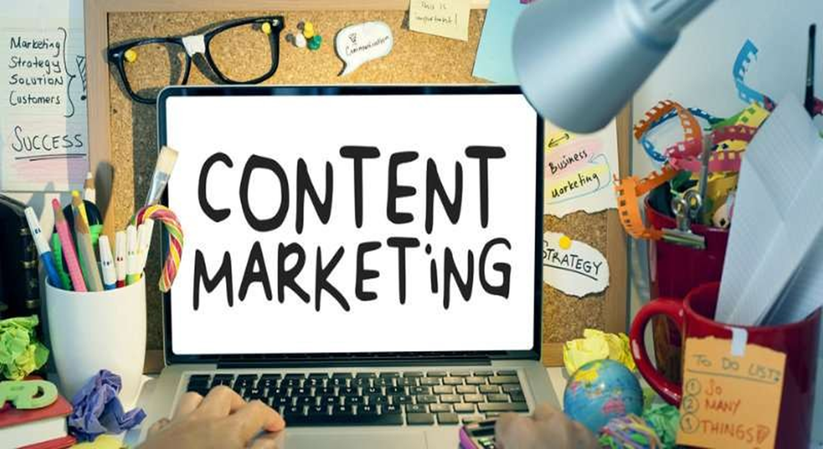
Content Marketing (CO3)

Slide 24
Content Marketing (CO3)
According to Joe Pulizzi, the Founder of Content Marketing Institute,
“Content marketing is a strategic marketing approach focused on creating and distributing valuable, relevant, and consistent content to attract and retain a clearly-defined audience — and, ultimately, to drive profitable customer action.”

Slide 25
Content Marketing (CO3)
In layman terms, this means that content marketing uses pieces of content, such as blogs, eBooks, newsletters, and videos, to deliver information across all stages of the marketing funnel.
The goal of content marketing is to increase the demand for a product or service through useful information.
Notes:
Through this, marketers educate their audience in the hopes of future conversions. Content marketing, like SEO, is a long play and requires a developed strategy to get the most out of your pieces.

Slide 26
Content Marketing (CO3)
The Practice of creating relevant and compelling content in a consistent fashion to a targeted buyer, focusing on all stages of the buying process.
Even though content marketing intends to generate leads, the material should not read as an advertisement or sales pitch.

Slide 27
Content Marketing (CO3)
The buying process is guided by buyer behavior, which progresses in the following four stages:
Discover: A customer determines the need to solve a problem
Explore: Needs are refined into requirements and potential vendors are contacted
Buy: Vendors submit offers and the solution is acquired
Engage: Onboarding is completed and the service is provided

Slide 28
Content Marketing (CO3)
According to Victoria Harres, Vice President of strategic communications at PR Newswire, explains:
“Content marketing is about sharing information that has real value to your target audience and educates your potential customers; not about your products, but topics that strongly support what you sell.”

Slide 29
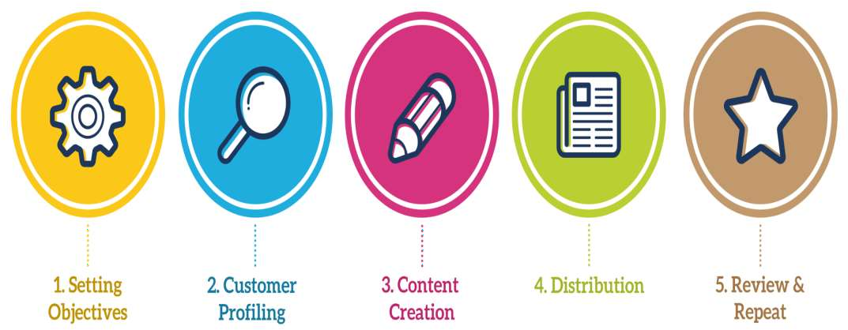
Content Marketing Steps (CO3)

Slide 30
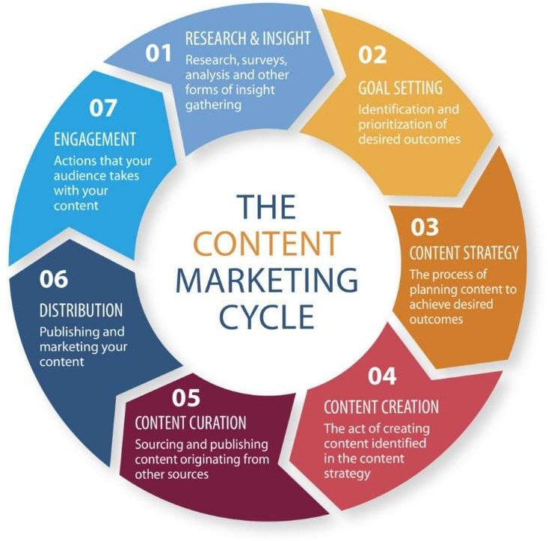
Content Marketing Cycle (CO3)

Slide 31
The Impact of Content Marketing on Sales (CO3)
1. It is an Educational Tool
2. It Furthers Brand Awareness
3. It Complements Paid Media
4. It Works Together with SEO
5. It Can Be Used as Sales Material
6. It Drives Your Website Design

Slide 32
Daily Quiz
Content marketing is about sharing information that has real value to your target audience and educate your potential customers. (True/False)
Explain the impact of Content on Sales.
The buying process is guided by _____________
The goal of ________ is to increase the demand for a product or service through useful information.

Slide 33
Noida Institute of Engineering and Technology, Greater Noida
(Unit –III) Topic 2
Search Marketing- SEM and SEO

Slide 34
Recap
Content marketing uses pieces of content, such as blogs, eBooks, newsletters, and videos, to deliver information across all stages of the marketing funnel. Through this, marketers educate their audience in the hopes of future conversions.

Slide 35
Session Objective
Students will understand the relevance of search engine marketing.
Students will get basic knowledge of SEO and PPC.

Slide 36
Search Marketing (CO3)
Search Marketing is a tactic used to gain online presence and traffic via paid and unpaid strategies on search engines such as Google, Bing, and Yahoo.
Visualize the last time you searched for something whether that be on Google, Yahoo, or Bing.

Slide 37
Search Marketing (CO3)
The text you typed into that small search box is called your “search query,” which then directs you to a page similar to the image below. This page is known as a SERP or Search Engine Results Page.
Various studies have found that the higher you are on the SERPS the more likely you are to gain traffic to your website. But the question is how does Google determine who gets these top placements? This is where search marketing comes into play.

Slide 38
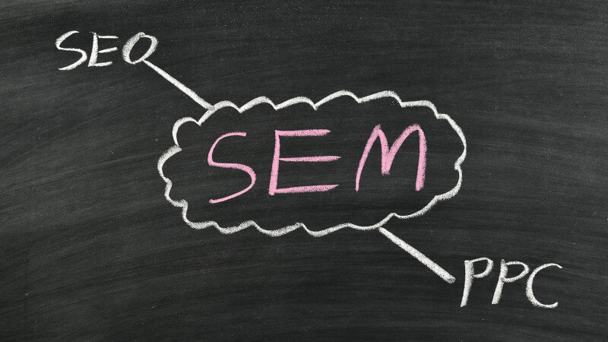
Search Marketing (CO3)

Slide 39
Search Marketing (CO3)
Search Marketing is divided into two main categories:
SEO (Search Engine Optimization): Gaining search engine listings via unpaid tactics.
PPC (Pay-per-click or paid advertising): Gaining search engine listings via paid tactics.
SEO - An approach that uses organic methods to appear in search results.
SEM - An approach that uses paid methods to appear in search results.

Slide 40
Search Marketing (CO3)
2 types of the Search Marketing
SEM : search engine marketing
SEO : search engine optimization

Slide 41
Search Marketing (CO3)
Purpose of Search Marketing
Acquire New Customers
Retain Old Customers
Create Awareness by means of Content marketing
Engage the customers to make 1st purchase by offering freebies

Slide 42
Search Marketing (CO3)
Search Marketing is a term that refers to both paid and unpaid search activities. It is used as an umbrella term for SEO and Search Engine Marketing (SEM).
Both are online techniques for increasing a brand or product’s visibility to audiences using search engines to find information.
Be careful with this last term: SEM is just about paid ads and does not include SEO.

Slide 43
Search Marketing (CO3)
It is a marketing method that focus on ads displayed on the search engines results, typically appearing on the top or on the right of the SERP.
Basically, the higher the bid one offers to pay for an ad, the higher the ad will be on the page, depending of the degree of competition.

Slide 44
Search Engine Marketing (CO3)
Search engine marketing is the practice of marketing a business using paid advertisements that appear on search engine results pages (or SERPs).
Advertisers bid on keywords that users of services such as Google and Bing might enter when looking for certain products or services, which gives the advertiser the opportunity for their ads to appear alongside results for those search queries.

Slide 45
Search Engine Marketing (CO3)
These ads, often known by the term pay-per-click ads, come in a variety of formats.
Some are small, text-based ads, whereas others, such as product listing ads (PLAs, also known as Shopping ads) are more visual, product-based advertisements that allow consumers to see important information at-a-glance, such as price and reviews.
Search engine marketing’s greatest strength is that it offers advertisers the opportunity to put their ads in front of motivated customers who are ready to buy at the precise moment they’re ready to make a purchase.

Slide 46
Search Engine Marketing (CO3)
Search Engine Marketing or paid search is divided between these terms:
Paid search ads
Paid search advertising
PPC (pay-per-click)
Notes:
PPC (pay-per-call) – some ads, particularly those served to mobile search users, may be charged by the number of clicks that resulted in a direct call from a smartphone.

Slide 47
Overview of search engine optimization (SEO) (CO3)
SEO stands for Search Engine Optimization.
SEO is all about optimizing a website for search engines. SEO is a technique for:
Designing and developing a website to rank well in search engine results.
Improving the volume and quality of traffic to a website from search engines.
Marketing by understanding how search algorithms work, and what human visitors might search.
Notes:
SEO is a subset of search engine marketing. SEO is also referred as SEO copyrighting, because most of the techniques that are used to promote sites in search engines, deal with text.

Slide 48
Search engine Optimization (CO3)
Search engines perform several activities in order to deliver search results
Crawling– Process of fetching all the web pages linked to a website. This task is performed by a software, called a crawler or a spider (or Google bot, in case of Google).
Indexing– Process of creating index for all the fetched web pages and keeping them into a giant database from where it can later be retrieved. Essentially, the process of indexing is identifying the words and expressions that best describe the page and assigning the page to particular keywords.

Slide 49
SEO Copywriting (CO3)
SEO Copywriting is the technique of writing viewable text on a web page in such a way that it reads well for the surfer, and also targets specific search terms. Its purpose is to rank highly in the search engines for the targeted search terms.
Notes:
Copywriting is the art and science of creating content that prompts the reader/end-user to either buy a product, subscribe to a list, take a test drive, or take some other action that will improve your appeal to the end-user (customers, clients, prospects, readers, etc.),

Slide 50
SEO Copywriting (CO3)
A copywriter is someone who understands people, knows what his audience likes and chooses the words that will appeal to them.
The headline, words, phrases, sentences and paragraphs used in the content have to persuade and cause readers to take a specific action.
An SEO copywriter also understand how Google feels about certain words and phrases, especially long tail phrases.
Notes:
Copywriting is salesmanship.

Slide 51
SEO(CO3)
What is On-Page and Off-page SEO?
On-Page SEO focuses on optimizing elements within your website, such as content, meta tags, URLs, and user experience, to make it more attractive to search engines and users. Off-Page SEO involves external activities, primarily around building high-quality backlinks and engaging in practices that enhance your website's authority and reputation on the web. Both are essential for a comprehensive SEO strategy to improve search engine rankings and drive organic traffic.
On-Page SEO– It includes providing good content, good keywords selection, putting keywords on correct places, giving appropriate title to every page, etc.
Off-Page SEO– It includes link building, increasing link popularity by submitting open directories, search engines, link exchange, etc.

Slide 52
Search Engine Optimization (CO3)
As discussed, this is the process of gaining presence via unpaid efforts. The ads that appear on the SERPS that are unpaid are known as organic results, which are found below the paid search ads. See the image below – the ads which are organic are the ones found in the green box below the top paid placements highlighted in blue.

Slide 53
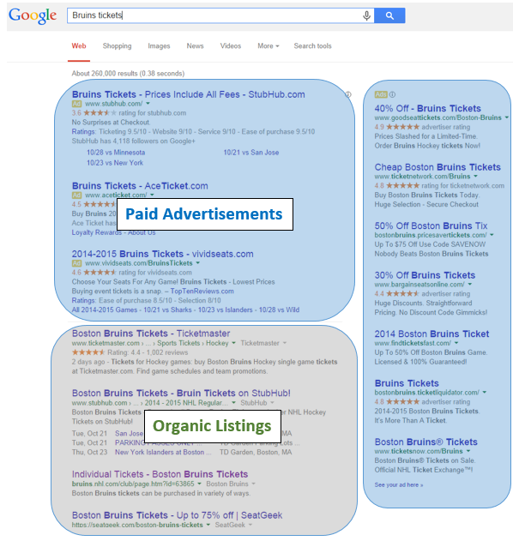
Search Engine Optimization (CO3)

Slide 54
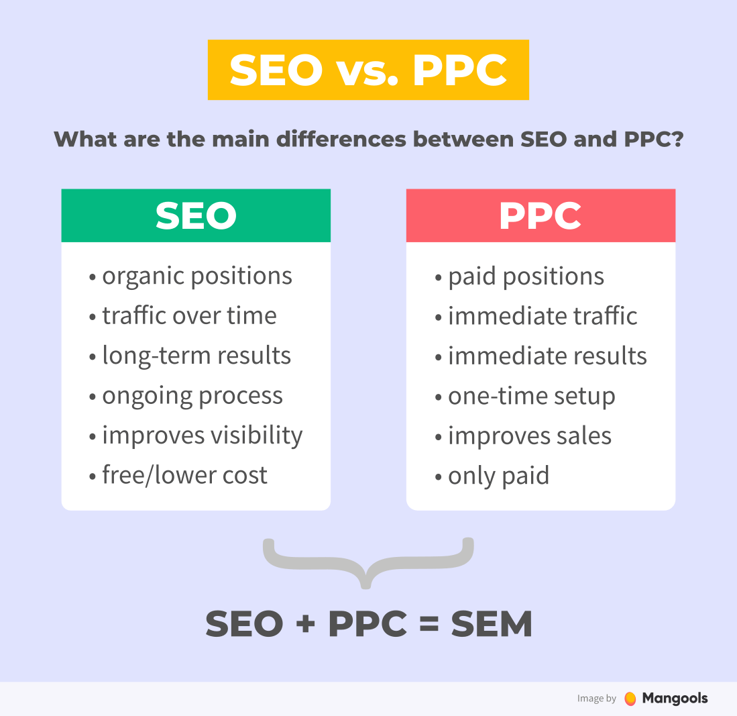
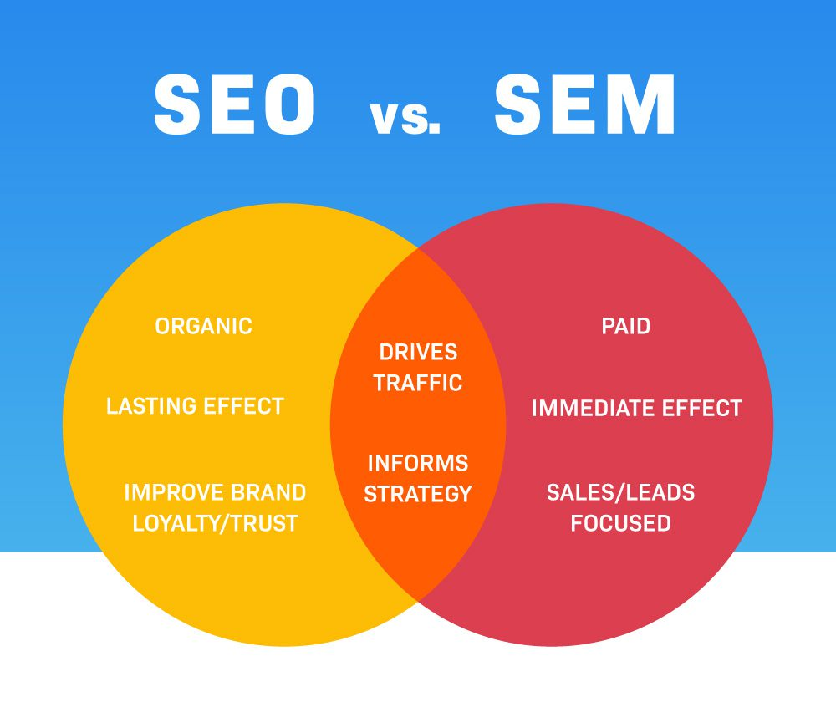
Search Engine Optimization (CO3)
There are several things you can do such as improve your chances of being ranked organically such as rewriting content to match keywords, write meta tags to match keywords, create more quality content to build authority, get other sites to link to your site, and maintain an active presence on social media to help create external links.

Slide 55
Daily Quiz
2 types of search marketing are: ________ & _______.
Search Marketing is always paid. (True/False)
SEO stands for ________.
Unpaid advertisements are called Organic listings.
SERP stands for Search engine review page. (True/ False)

Slide 56
Noida Institute of Engineering and Technology, Greater Noida
(Unit –III) Topic 3
Social Media Marketing, Mobile Marketing and Video Marketing

Slide 57
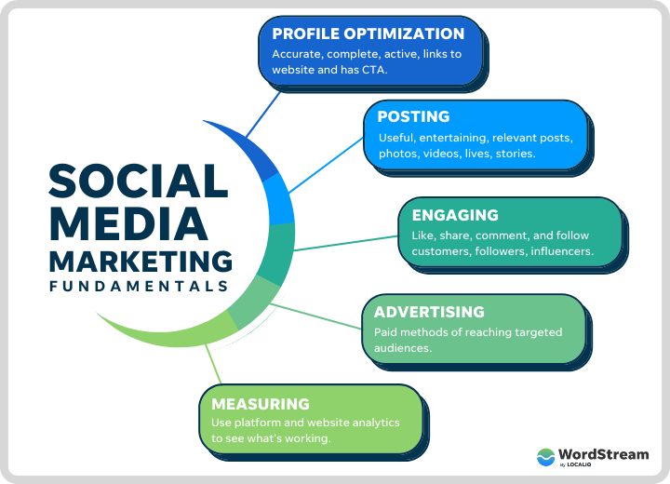
Social Media Marketing (CO3)

Slide 58
Social Media Marketing (CO3)
Social media marketing is the use of social media platforms and websites to promote a product or service.
Although the terms e-marketing and digital marketing are still dominant in academia, social media marketing is becoming more popular for both practitioners and researchers.

Slide 59
Social Media Marketing (CO3)
Social media marketing can help with a number of goals, such as:
Increasing website traffic
Building conversions
Raising brand awareness
Creating a brand identity and positive brand association
Improving communication and interaction with key audiences

Slide 60
Social Media Marketing (CO3)
Social media marketing, or SMM, is a form of internet marketing that involves creating and sharing content on social media networks in order to achieve your marketing and branding goals.
Social media marketing includes activities like posting text and image updates, videos, and other content that drives audience engagement, as well as paid social media advertising.

Slide 61
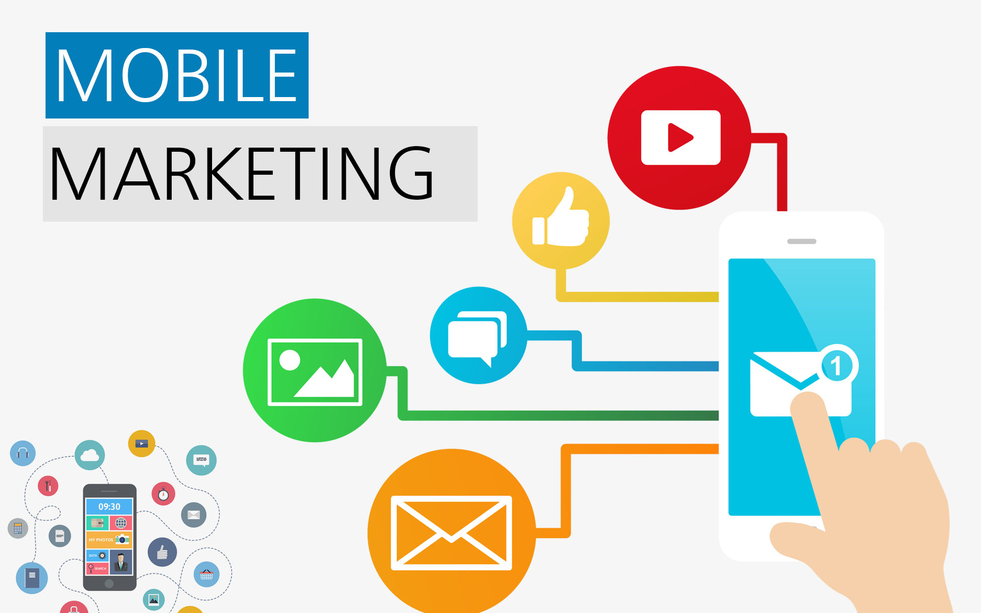
Mobile Marketing (CO3)
Notes:
Mobile is disrupting the way people engage with brands. Everything that can be done on a desktop computer is now available on a mobile device.

Slide 62
Mobile Marketing (CO3)
Mobile marketing is a multi-channel, digital marketing strategy aimed at reaching a target audience on their smart phones, tablets, and/or other mobile devices, via websites, email, SMS and MMS, social media, and apps.
80% of internet users own a smartphone.
Notes:
Mobile is disrupting the way people engage with brands. Everything that can be done on a desktop computer is now available on a mobile device.

Slide 63
Mobile Marketing (CO3)
Google says search queries on mobile devices have already surpassed desktop searches.
Effective mobile advertising means understanding your mobile audience, designing content with mobile platforms in mind, and making strategic use of SMS/MMS marketing and mobile apps.
Notes:
Mobile platforms, such as smartphones and tablets, host up to 60% of digital media time for users in the U.S.

Slide 64
Mobile Marketing (CO3)
When it comes to mobile marketing, this means keeping devices in mind and utilizing SMS/MMS marketing and mobile apps.
From email, to pay-per-click (PPC), search engine optimization (SEO), content marketing, and social media marketing, there is a mobile marketing channel to reach every part of your audience where they are most comfortable.
Mobile marketing is a multi-channel, digital marketing strategy aimed at reaching a target audience on their smartphones, tablets, and/or other mobile devices, via websites, email, SMS and MMS, social media, and apps. In recent years, customers have started to shift their attention (and dollars) to mobile.
Notes:
For mobile marketing to be effective, you need to curate a cohesive experience that customers expect—and that can be a real challenge as you work to acquire, engage, and retain users across a variety of platforms.

Slide 65
Mobile Marketing (CO3)
Why is mobile marketing important?
Users spend 89% of their time on mobile apps, making mobile devices dominate communication.
The overall view and amount of content on mobile devices are simplified due to their smaller size. As mobile devices are smaller and lighter than computers, users can easily carry them everywhere and make purchases at any time they want.
Mobile hastens the time to purchase by 20 percent.

Slide 66
Mobile Marketing (CO3)
Why is mobile marketing important?
Compared to a year ago, 50 percent of smartphone users expect to buy something immediately while using their devices.
Ninety-one percent of smartphone users plan purchases or buy individual items after seeing relevant ads.
2/3 of customers who use smartphones are likely to purchase from businesses that have apps or mobile websites with content customized to their location.
Forty percent of online transactions occur on mobile devices.

Slide 67
Type of Mobile Marketing (CO3)
Mobile app marketing. Mobile apps allow businesses to include ads in specific mobile application designs. Facebook is an excellent example of ads in an app.
In-game advertisements. This approach refers to all advertisements on mobile devices that pop up when certain games are opened or in progress. These ads can appear as full-image ads, banner pop-ups, or video ads that show up during loading screens.

Slide 68
Type of Mobile Marketing (CO3)
Quick-response barcode (QR codes). These barcodes are scanned using the camera of a phone, and then the customers are redirected to the linked site from where they can see more information regarding a particular brand.
Proximity or Bluetooth marketing. With this approach, consumers get location-specific ads enabled from the Bluetooth on their devices.

Slide 69
Type of Mobile Marketing (CO3)
Voice marketing. This is when businesses use computer produced and automated calls to promote their goods or services. It is up to the customer to decide whether to hang up or listen to the phone call.
SMS marketing. This method of mobile marketing is, by far, the most common. Marketers use this medium to reach out to customers with offers and other relevant information via their mobile gadgets. SendPulse makes it possible by offering professional features for effective mobile marketing.

Slide 70
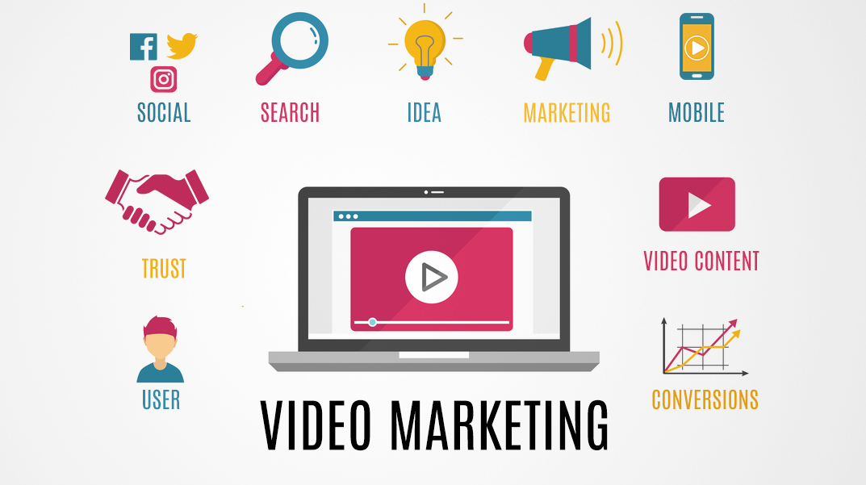
Video marketing (CO3)

Slide 71
Video marketing (CO3)
Video marketing refers to the use of video to market or promote your brand or offering on digital channels.
In simple terms, when you use video to market your brand, product or service, engage on social media channels, educate your prospective and current customers, and interact with them, you’re said to be using video marketing.
Video marketing can be used for everything from building customer rapport, to promoting your brand, services or products.
Notes:
Video marketing, a forward-facing marketing strategy that integrates engaging video into your marketing campaigns.

Slide 72
Video marketing (CO3)
Video marketing can be used for everything from building customer rapport, to promoting your brand, services or products. Additionally, video marketing can serve as a medium to present how-to’s, promote customer testimonials, live-stream events and deliver viral (entertaining) content.
Video marketing is all over the Internet. Look no further than your favorite brands, your Facebook, your YouTube homepage, and there it is: successful video marketing that has found its way to your eyes.

Slide 73
Video marketing (CO3)
To develop your video marketing strategy, you’ll want to:
Allocate resources
Tell your stories
Engage
Keep it short
Publish your videos far and wide
Analyze

Slide 74
Benefits of Video Marketing (CO3)
1. Video helps you connect with your audience.
2. Video is an SEO gold mine
3. Videos boost information retention.
4. Email subject lines that include the word “video” see a 19% increase in open rates, and a 65% boost in click-throughs.
5. After watching a video, customers are 64-85% more likely to make a purchase.

Slide 75
Challenges of Video Marketing (CO3)
Cost was a serious challenge to video marketing: The cost of equipment, editing software and, from an end-user’s perspective, the data cost of consuming online video.
Good equipment, editing software and a delivery platform are more affordable than they once were, but they’re not free – and you do need a marketing team with experience in video, but these are all surmountable obstacles.

Slide 76
Types Of Video Content (CO3)
Product Demo
Interviews
Testimonials
Event Videos
Explainer Videos
How-To Videos.

Slide 77
Types Of Video Content (CO3)
Vlog
Presentations & Talks
Tutorials
Behind The Scenes
Live Videos

Slide 78
Daily Quiz
The most common form of Mobile marketing is _____ marketing.
2. Which of the following is the most common delivery channel in terms of mobile marketing?
Graphic
Text
Voice call
Search engine marketing
________ marketing refers to the use of video to market or promote your brand or offering on digital channels.
Viral
Native
Mobile
Video

Slide 79
Daily Quiz
_________marketing is the use of social media platforms and websites to promote a product or service.
SMM stands for ______.
Name the different social media networks.
________ marketing is a sales technique that involves organic or word-of-mouth information about a product or service to spread at an ever-increasing rate.
________ marketing is the act of sending promotional messages to people in mass quantities

Slide 80
Noida Institute of Engineering and Technology, Greater Noida
(Unit –III) Topic 4
Marketing Gamification

Slide 81
Objective of Topic/Session
Students understand the concept of Market gamification and its relevance in Digital Marketing.

Slide 82
Marketing Gamification and Apps (CO3)
In terms of digital marketing, gamification can be defined as a set of all dynamic and entertaining solutions and elements you integrate into your website, app or email campaigns to make user’s experience with your service more diverting and engaging.
Carrying a sense of competition, gamification triggers excitement and gambling, encouraging people to get eager for achievements and rewards. And surely, people would use more often the website or app they have previously enjoyed interacting with.

Slide 83
Benefits of Gamification for the Marketing Strategy (CO3)
1. Gamification increases
average website session time;
average time spent reading an email;
audience engagement;
social sharing.
2. It makes the user experience more enjoyable and results in better satisfaction.

Slide 84
Benefits of Gamification for the Marketing Strategy (CO3)
3. Compared to other marketing tools, email gamification doesn’t require complex solutions or algorithms. A simple quiz or a challenge to find a hidden link can be implemented within a basic email template.
4. It helps collect customer data. Gamification uses different options to encourage people to provide personal info (contacts, product preferences) in exchange for bonuses (points, prizes, starts, achievements, badges, % off, etc.).

Slide 85
Main Principles of Gamification (CO3)
1. Achievable task.
2. Clear goal.
3. Engaging design.
4. Fun process.
5. Reward.

Slide 86
On-Site Gamification Examples (CO3)
Wheel of Fortune
Wheel of Fortune is an entertaining element that gives visitors a chance to receive a small gift, and the brand – collect the customer data (name, email address, sometimes phone number) and encouraging the first purchase at the same time.

Slide 87
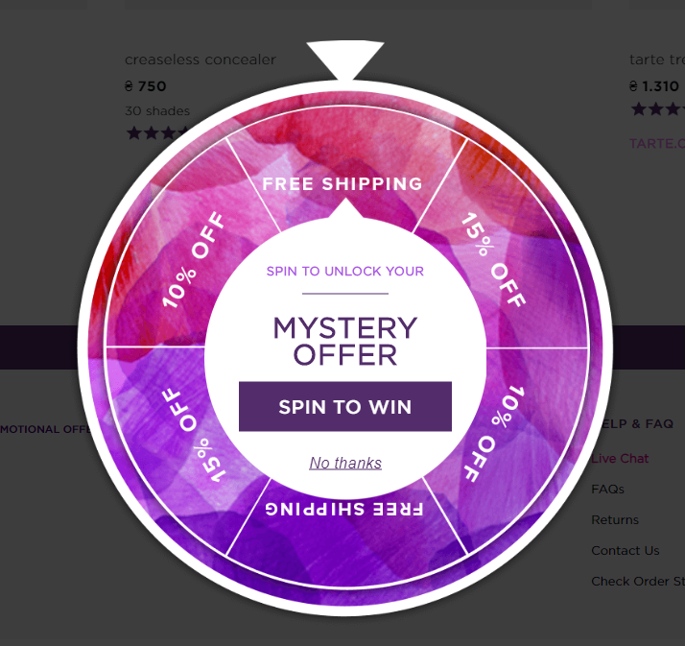
On-Site Gamification Examples (CO3)

Slide 88
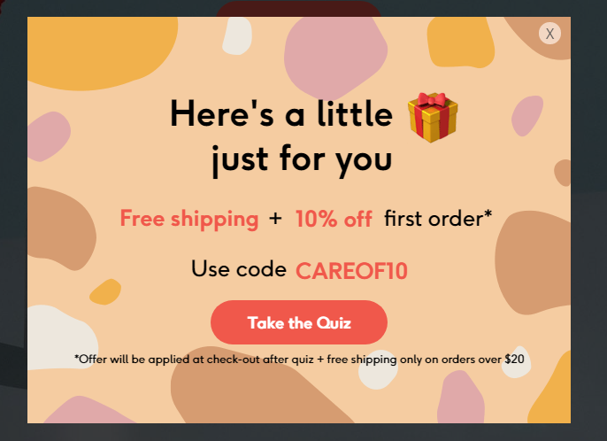
On-Site Gamification Examples (CO3)
A quiz is another gamification element that helps get contacts and get more information on customer’s preferences.

Slide 89
On-Site Gamification Examples (CO3)
Badges
Badge system is a great way to build customer loyalty: a badge can be a good reward for using the product within a long period, making it through different stages.
It’s always exciting to unlock new levels and collect new trophies, so customers like this way of interaction.
Notes:
The same principle lies behind bonuses, membership rewards, progress-based points and certificates, etc. Offering prizes for step-by-step completion of a particular process helps retain customers and build a committed audience.

Slide 90
On-Site Gamification Examples (CO3)
Goibibo – Gamification for Travel
Goibibo had gamified their app to capitalize on the current trend: Indian Premier League.
The app introduced goCashFest, where users can earn GoCash when time the Mumbai Indians play.
By using the app while the team plays, users win GoCash for each 4s, 6s, 50, 100, wickets and wins during the match.
This goCash is valid until the next Mumbai Indians match and can be used to make bookings on Goibibo.

Slide 91
On-Site Gamification Examples (CO3)
Byju’s – Gamification for Education
Byju’s uses gamification by allowing students to play games, earn reward points, and challenge each other through different quizzes and competitions. Competing with each other motivates students to work for better results.
This sort of gamification results in a win-win situation for the app as well as its users.

Slide 92
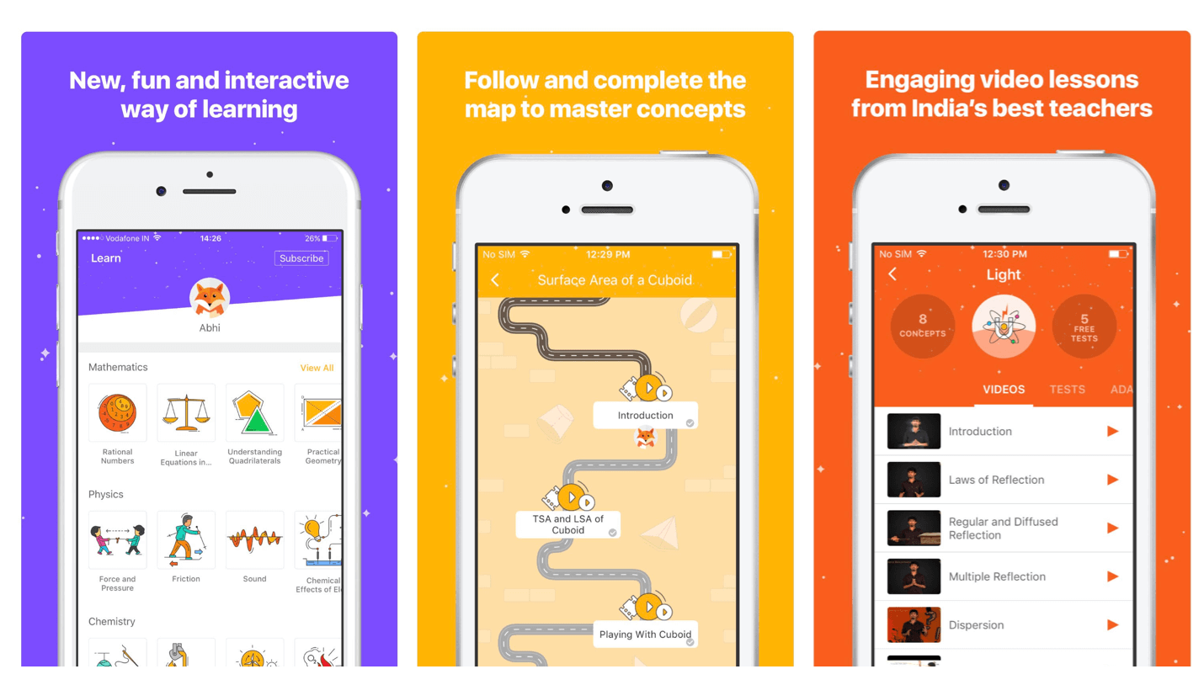
On-Site Gamification Examples (CO3)

Slide 93
On-Site Gamification Examples (CO3)
Starbucks – Gamification for Loyalty Programs
The Starbucks app features a loyalty system that rewards users with stars for each order placed, which can then be redeemed for free food and drinks.
https://www.youtube.com/watch?v=gfFgga9XY7k&t=28s

Slide 94
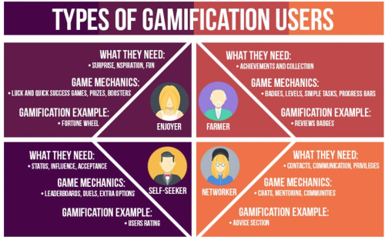
Marketing Gamification and Apps (CO3)

Slide 95
Gamification Marketing benefits (CO3)
Games allow companies to attract fans in social media by also constituting an important element of competition.
Games allow education and integration of members of group or branch.
Games can provide consumers with a positive fun filled and entertaining experience.
Games permit companies to simulate real life situations that customers identify with easily in such a way that target group gets more engaged.

Slide 96
Daily Quiz
Gamification makes the user experience more enjoyable. (True/ False)
Name any 2 types of Gamification users.
______ is defined as a set of all dynamic and entertaining solutions and elements integrated into website, app or email campaigns.
_____ is an example of Marketing gamification.
________ allow companies to attract fans in social media by also constituting an important element of competition.

Slide 97
Noida Institute of Engineering and Technology, Greater Noida
(Unit –III) Topic 5
Marketing analytic tools to segment, target and position.

Slide 98
Marketing analytic tools to segment, target and position
When used correctly, analytics can provide you with an immense pool of information, an d can really help you to pinpoint effective marketing strategies and target you r market correctly. Today we are going to look at how marketing analytics tools can help you segment and target new readers, how to differentiate between customers and your target audience, and finally how to read key metrics via conversion tracking.
Target Audience
Google Analytics Dashboard Know where Visitors Comes From
Adwords Conversion Tracking

Slide 99
Marketing analytic tools to segment, target and position
Target Audience
Google Analytics can really provide you with a myriad of information ,as long as you know where to find it and how to read the data. Website metrics will help you review user traffic and define all types of information about you r visitors. This, in turn, will give you the opportunity to see exactly where your visitors are coming from ,and even why they are visiting your content. Analytics should become a key part of your business, objectives as they can be used to help you develop all types of areas of your business: sales (ecommerce), lead generation, content publishing, online information , and branding. Analytics can easily be used as a way to segment your traffic or your users and define you r target audience, which will then help you identify areas where you can target new readers.

Slide 100
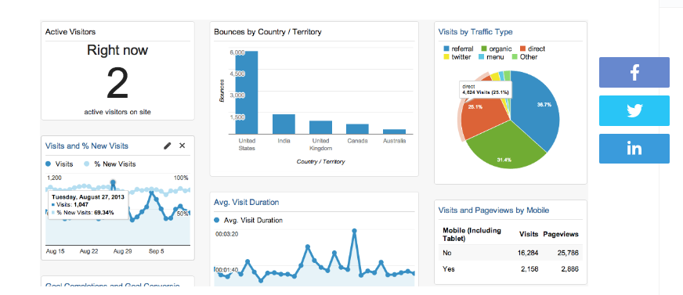
Marketing analytic tools to segment, target and position
Google Analytics

Slide 101
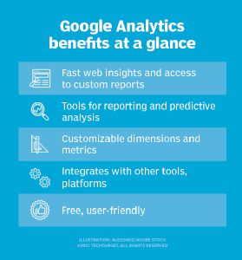
Marketing analytic tools to segment, target and position
Google Analytics

Slide 102
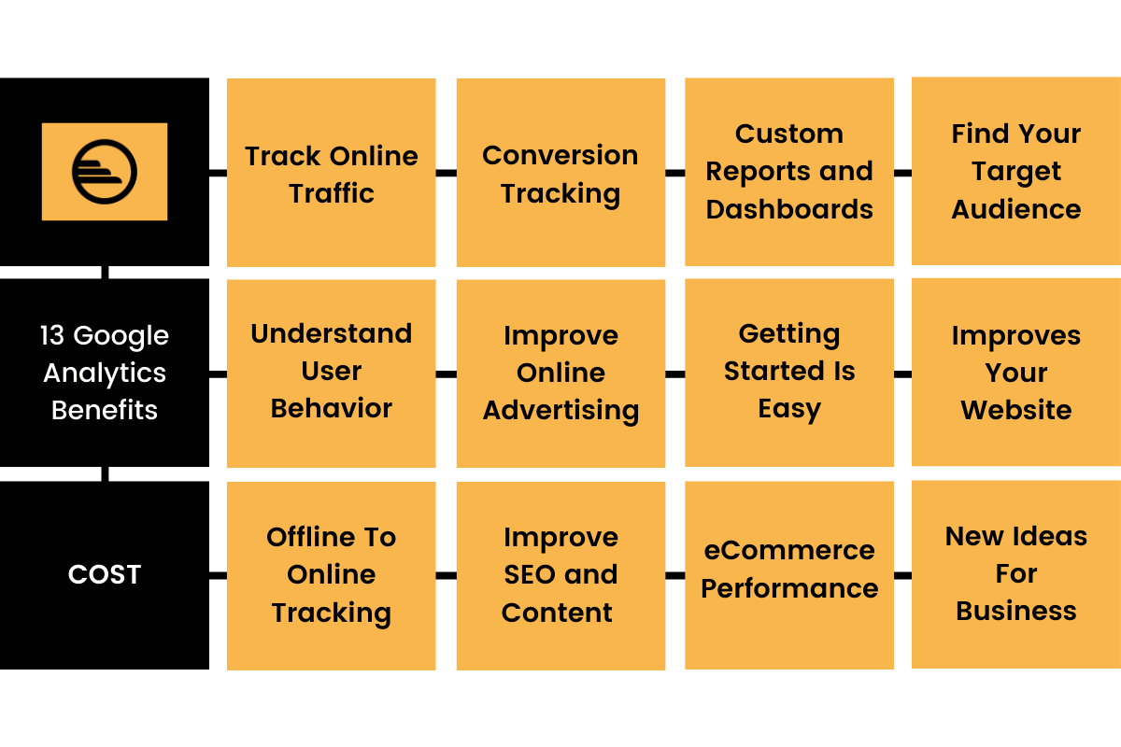
Marketing analytic tools to segment, target and position
Google Analytics

Slide 103
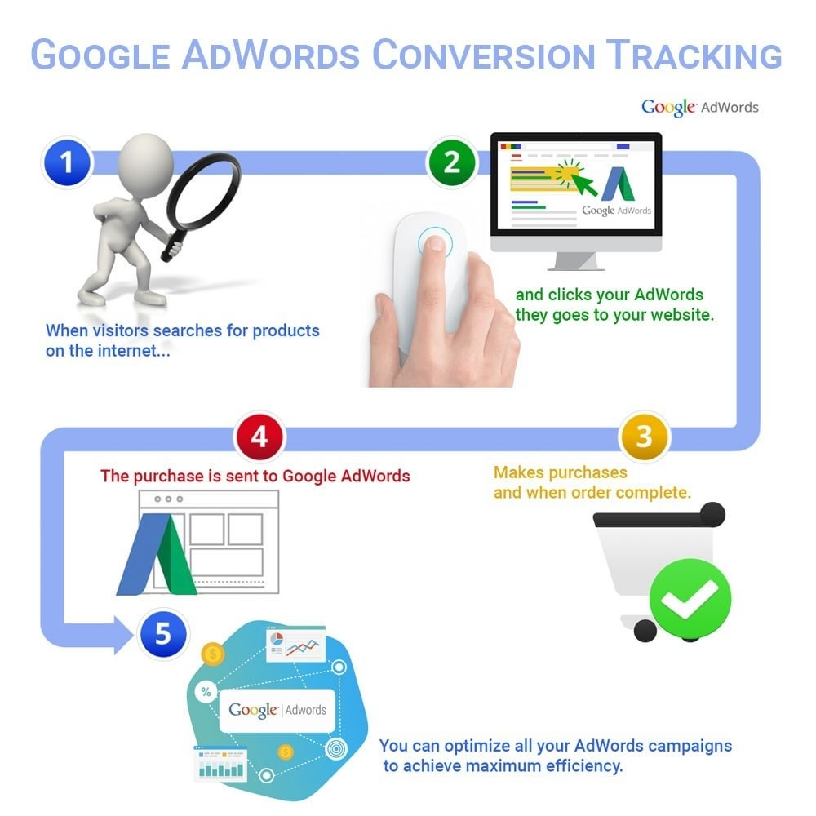
Marketing analytic tools to segment, target and position
Adwords Conversion Tracking

Slide 104
Google Analytics, AdWords, and other on line analytics and advertising tools all contain a huge pool of information that will help you create not only your own brand, but also develop and grow you r target audience and pi n point advertising strategies that work for you. All of this information can help you grow your business and there are many extensive guides available on line for free. You can't go wrong with using all of this available data to your advantage!

Slide 105
Topic Links and Online Courses details
https://www.youtube.com/watch?v=0R_3iarc8IA
https://www.youtube.com/watch?v=kAjtioDwM58
https://www.youtube.com/watch?v=gfFgga9XY7k&t=31s
https://academy.hubspot.com/courses/content-marketing
https://www.coursera.org/learn/content-marketing

Slide 106
Assignment
Q1.State the importance of content in Online marketing?
Q2.State the two major types of search marketing techniques ?
Q3. Write short notes on : i) Mobile marketing ii) Viral marketing
Q4.Discuss the different types of Gamification strategies used in digital marketing with examples.

Slide 107
MCQs
Q1.________ is the process of marketing accomplished or facilitated via the use of internet technologies (e.g. web, email, intranet, extranets).
a) Internet marketing
b) Search marketing
c) e-marketing
d) Mobile marketing
Q2. This form of advert delivered on social platforms and social gaming websites and apps, across all device types is known as:
a) mobile marketing
b) social media advertising
c) internet advertising
d) e-marketing
Q3. A form of marketing communications that uses the internet for the purpose of advertising, aiming to increase website traffic and/or encourage product trial, purchase, and repeat purchase activity is called:
a) Search marketing.
b) E-mail marketing.
c) Internet advertising.
d) Social web marketing.

Slide 108
MCQs
Q4. An advertising model in which advertisers bid on keywords or phrases relevant to their target market, with sponsored/paid search engine listings to drive traffic to a website is called:
a) Search Engine Optimization (SEO).
b) Contextual Advertising.
c) Digital Asset Optimization (DAO).
d) Pay Per Click (PPC).
Q5.____________ is a form of digital marketing that describes the use of the social web and social media (e.g. social networks, online communities, blogs or wikis) or any online collaborative technology for marketing activities, be it sales, public relations, research, distribution or customer service.
a) Pay Per Click (PPC)
b) Digital Asset Optimization (DAO)
c) Social Media Marketing (SMM)
d) Search Engine Optimization (SEO)
Q6. ____________ is the set of practices that enables organizations to communicate and engage interactively with their audiences through any mobile device or network.
a) Mobile marketing
b) Social web marketing.
c) Internet marketing
d) Social media marketing

Slide 109
Glossary
In game advertisement, Crawling, Marketing gamification, Search engines, Search, content
1. ______ Marketing is a tactic used to gain online presence and traffic via paid and unpaid strategies
2. Wheel of fortune is an example of ________.
3. Google, Bing, and Yahoo are examples of _________.
4. _______ marketing uses pieces of content, such as blogs, eBooks, newsletters, and videos, to deliver information
5. ______ refers to all advertisements on mobile devices that pop up when certain games are opened or in progress
6. Process of fetching all the web pages linked to a website is called _______.

Slide 110
University Paper Links
https://www.uptunotes.com/aktu-paper-digital-marketing-mammk04-2018-19/
http://www.aktuonline.com/papers/mba-3-sem-digital-and-social-media-marketing-kmbmk03-2020.pdf
http://www.aktuonline.com/papers/mba-3-sem-digital-marketing-rmbmk03-2020.html
http://www.aktuonline.com/papers/mba-3-sem-digital-marketing-rmbmk-03-2018-19.html

Slide 111
Expected questions for University Exams
Q1.State the impact of content on Sales.
Q2.State the two major types of search marketing techniques ?
Q3.Give any two benefits of using search engine optimization to a marketer.
Q4.Discuss what is Mobile marketing.
Q5.Explain social media marketing ?
Q6. Discuss the relevance of gamification in marketing.
Q7.Explain in detail Marketing analytic tools to used for segmentation, targeting and positioning.
Q8. Explain in detail Video marketing and social media marketing.

Slide 112
Sessional Question paper (Online)
Objective Paper
https://forms.office.com/r/kNi2FiFC0f
Subjective Paper
https://forms.office.com/r/h8K7Auphdm

Slide 113
Sessional Question paper

Slide 114
Sessional Question paper

Slide 115
Sessional Question paper

Slide 116
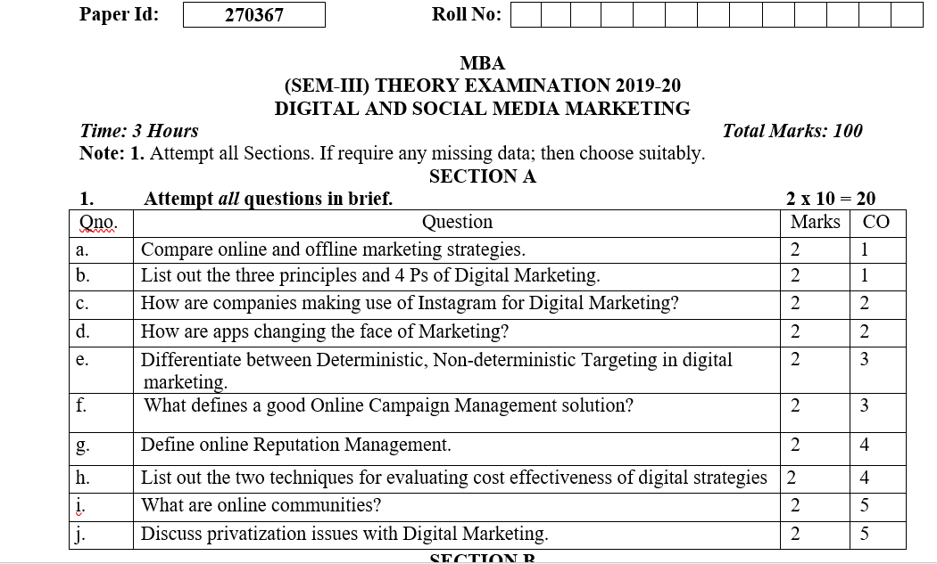
End Semester Question paper

Slide 117
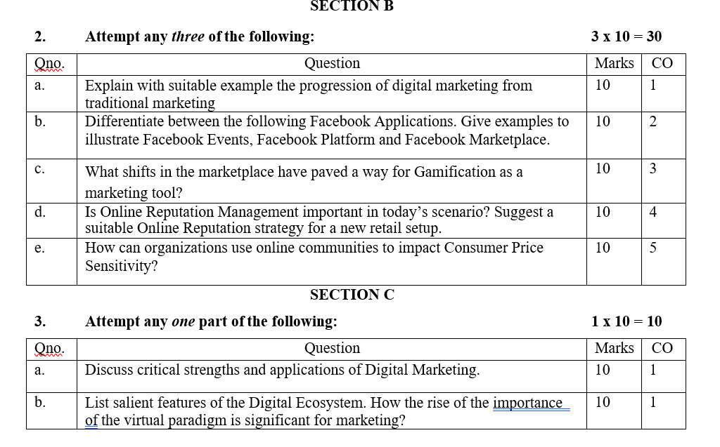
End Semester Question paper

Slide 118
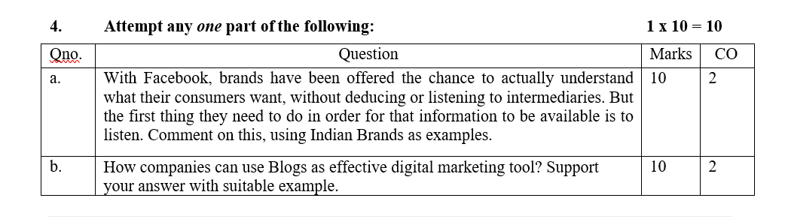
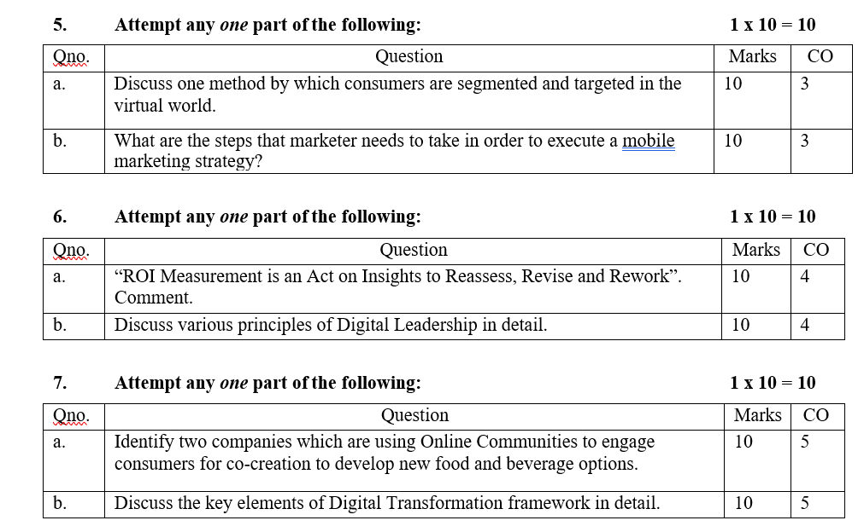
End Semester Question paper

Slide 119
Summary
Search Engine Marketing(SEM) & Search Engine Optimization (SEO) Both are online techniques for increasing a brand or product’s visibility to audiences using search engines to find information.
The future of marketing of gamification and apps marketing is about to enter a more challenging territory. Building on the vast increase in consumer power brought on by the digital age marketing is headed towards being on demand not just always on but also always relevant responsive to the consumer desire for marketing that cuts through the noise with pin point delivery.

Slide 120
References
https://www.forbes.com/sites/joshsteimle/2014/09/19/what-is-content-marketing/?sh=7367fd1510b9
https://developers.google.com/search/docs/beginner/seo-starter-guide
https://esputnik.com/en/blog/gamification-digital-marketing-formula-solutions-examples
Vandana, Ahuja; Digital Marketing, Oxford University Press India (November, 2015).
Moutsy Maiti: Internet Marketing, Oxford University Press India
Ryan, Damian; Understanding Digital Marketing: marketing strategies for engaging the digital generation; Kogan Page (3rd Edition, 2014).

